Slide 1
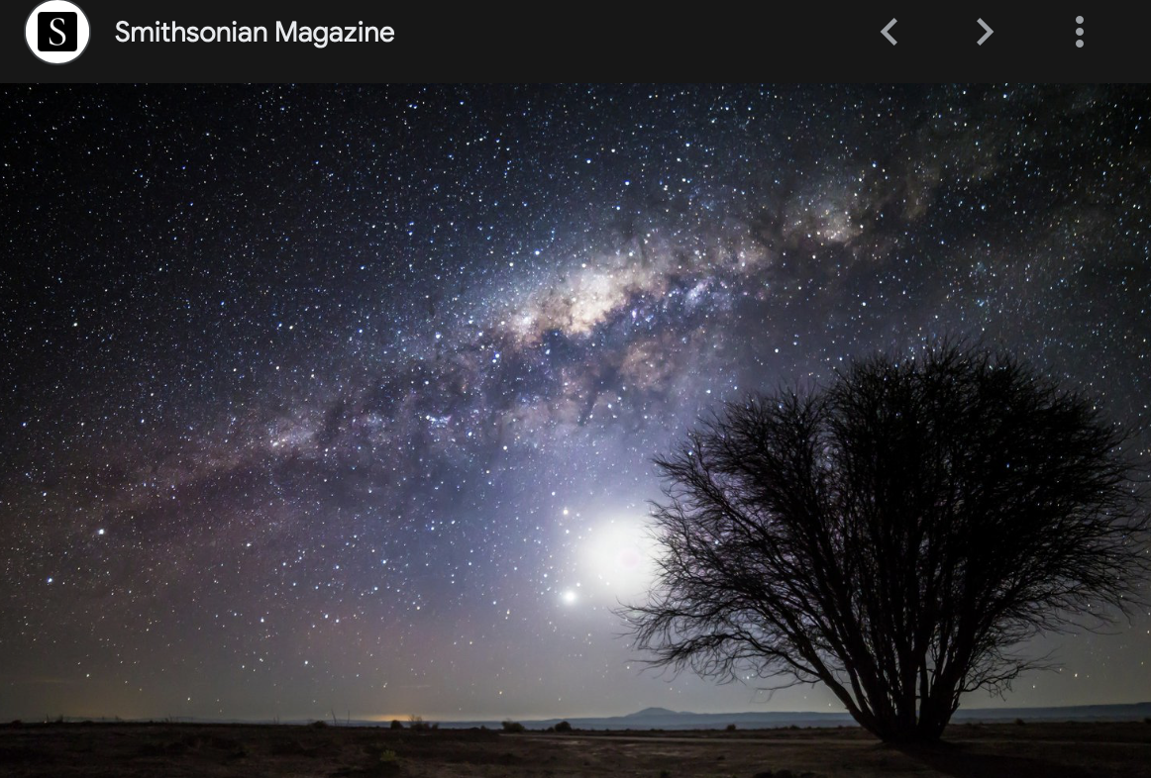
Science Drivers: the Milky Way and time domain
Željko Ivezić
Right: a view of the Galactic Center region from Chile

Slide 2
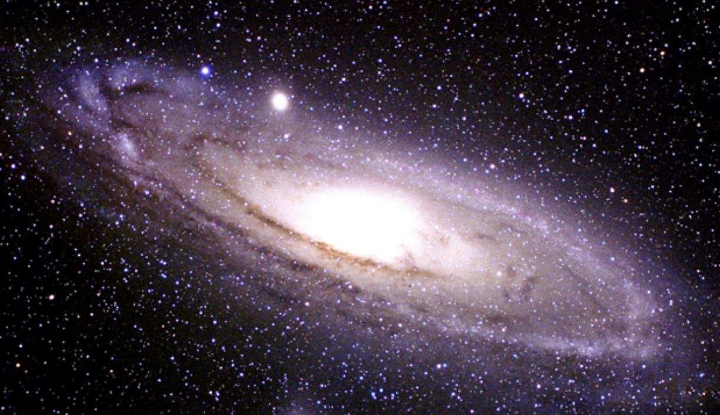
Outline
1) The Milky Way – our own galaxy
2) Time domain astronomy
3) Astronomical Surveys
4) Big Data and Machine Learning challenges
5) Discussion and Questions

Slide 3
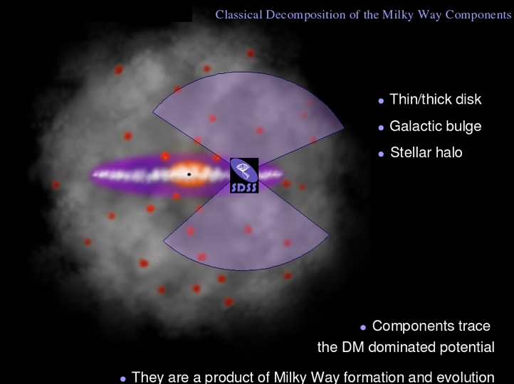
The Milky Way – our own galaxy

Slide 4
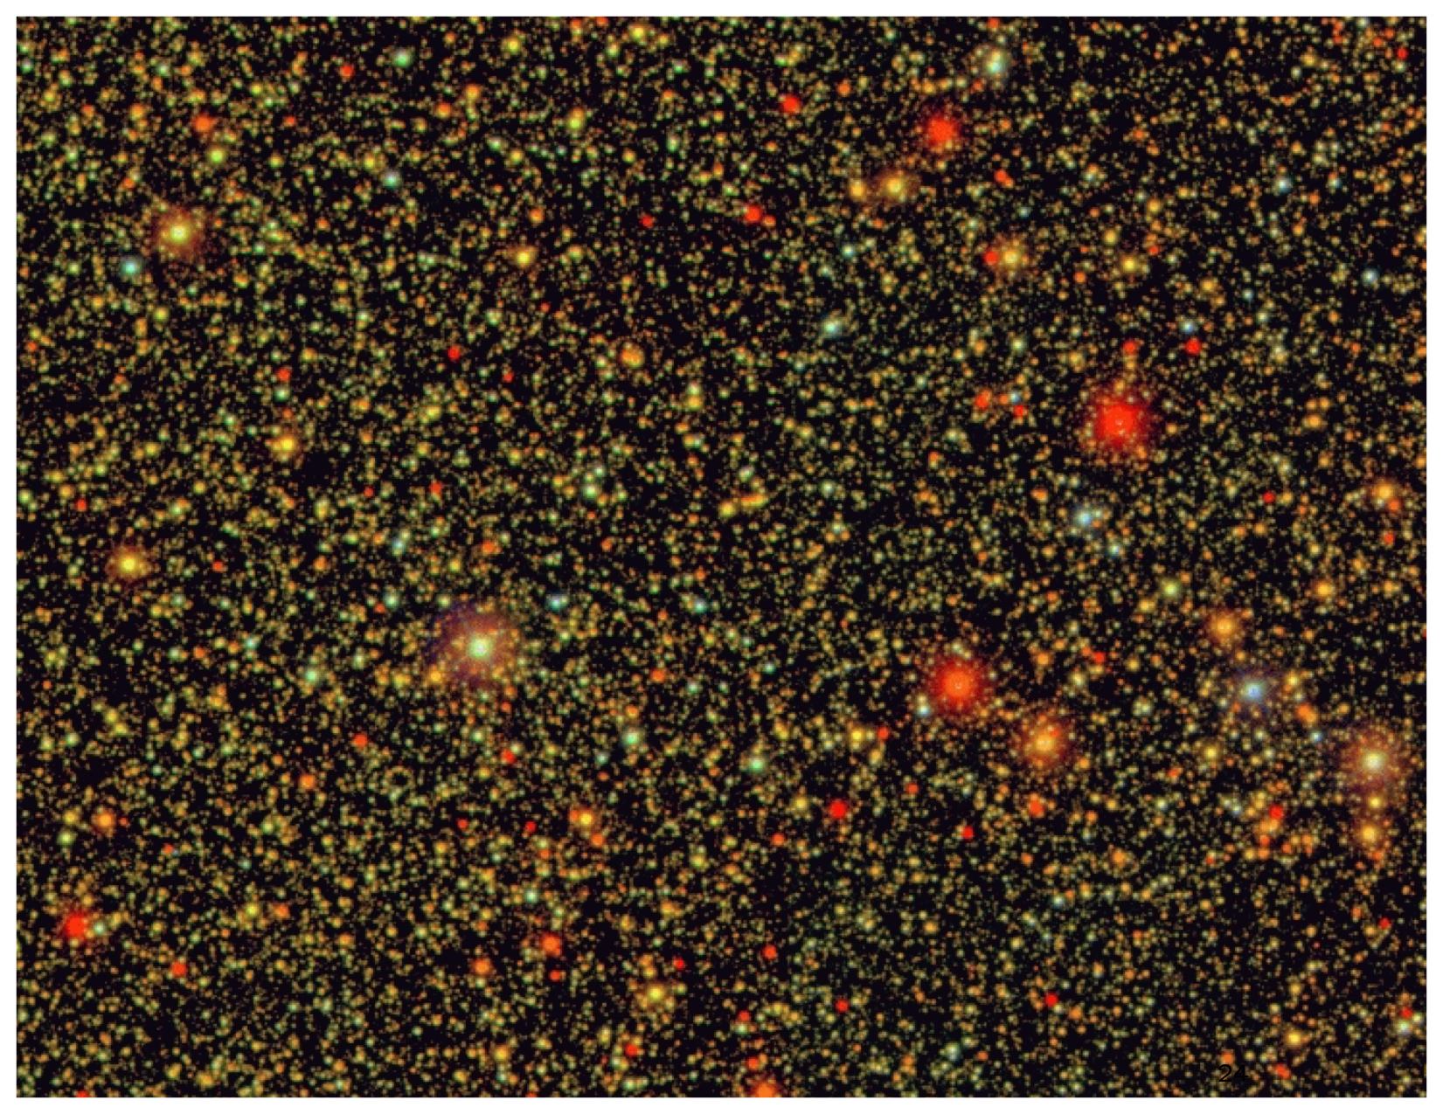
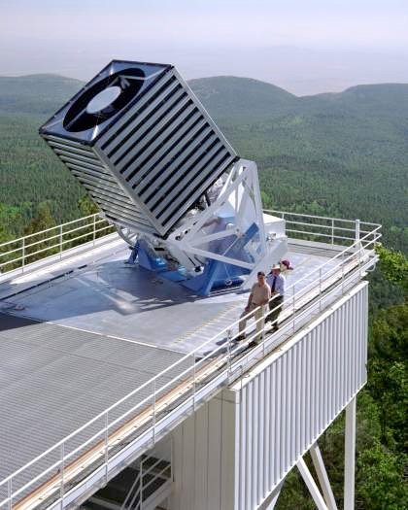
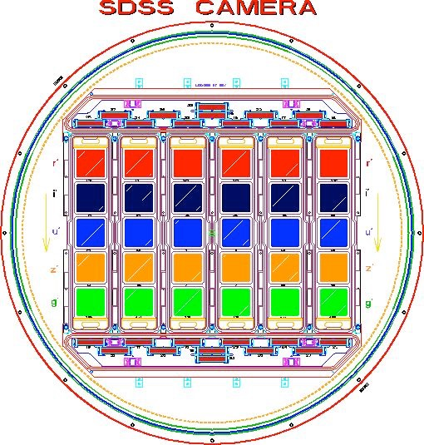
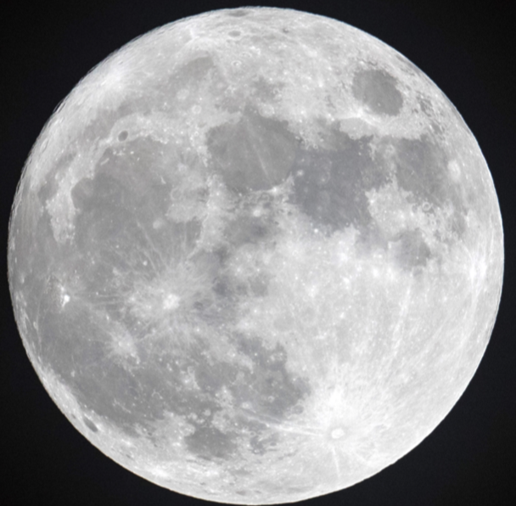
SDSS view along the Milky Way Disk
Moon for scale
Naked eye: 1 star in 200x larger area

Slide 5
SDSS
gri
3.5’x3.5’
r~22.5
3 arcmin is 1/10 of the full Moon’s diameter
LSST’s field of view is 3000 times larger

Slide 6
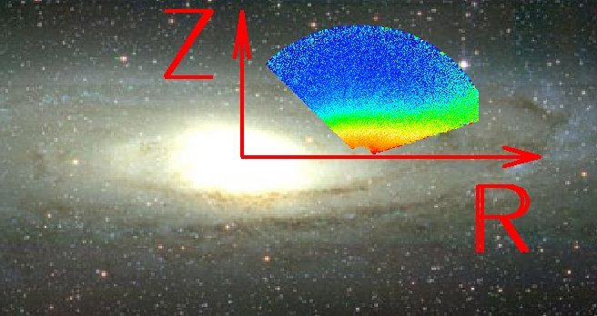
The Milky Way is complex and big!
And interesting and informative!

Slide 7
The Milky Way halo: not smooth, not simple...
Belokurov et al. (2006)
The halo structure is interesting because: 1) dynamical times are long (merger history), and 2) gravitational potential becomes dominated by the dark matter halo

Slide 8
Why to study the Milky Way?
To help answer general questions about galaxies:
How did galaxies form?
How did galaxies evolve?
What do they tell us about the Universe?
Disadvantage: a single spiral galaxy
A major advantage: no other galaxy can be studied in such an exquisite detail as our Galaxy
For individual stars in our Galaxy we can today measure/estimate: a) 3D positions (and luminosity) b) 3D motions (accelerations only close to the black hole) c) chemical composition ([Fe/H], [α/Fe], individual abundances) d) age and mass (sometimes) today: for billions of stars! 7-D space, at least
Ivezić, Beers, Jurić 2012, ARA&A, 50, 251

Slide 9
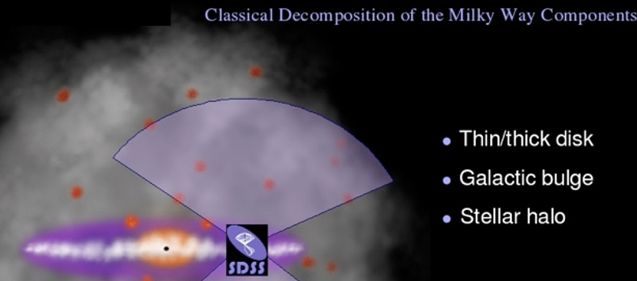
Big questions about the Milky Way:
Observers’ view:
Decompose Galaxy into main components:
Describe the spatial distribution of stars
Describe stellar kinematics as a function of position
Describe chemical composition as a function of position and kinematics (and ultimately age) that is, map the Galaxy in multi-D space
Theoreticians’/modelers’ view:
Can we understand/model the behavior of stars in the position-kinematics-chemistry space?
Can we use kinematics and other data to infer dynamics?
Are the results from the Milky Way studies consistent with extragalactic constraints?

Slide 10
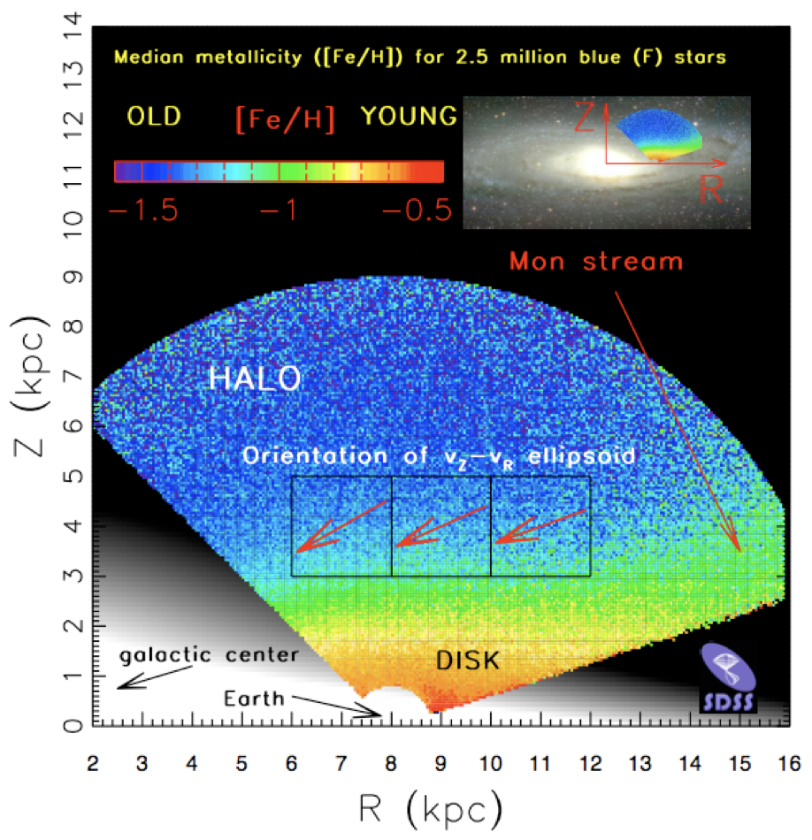
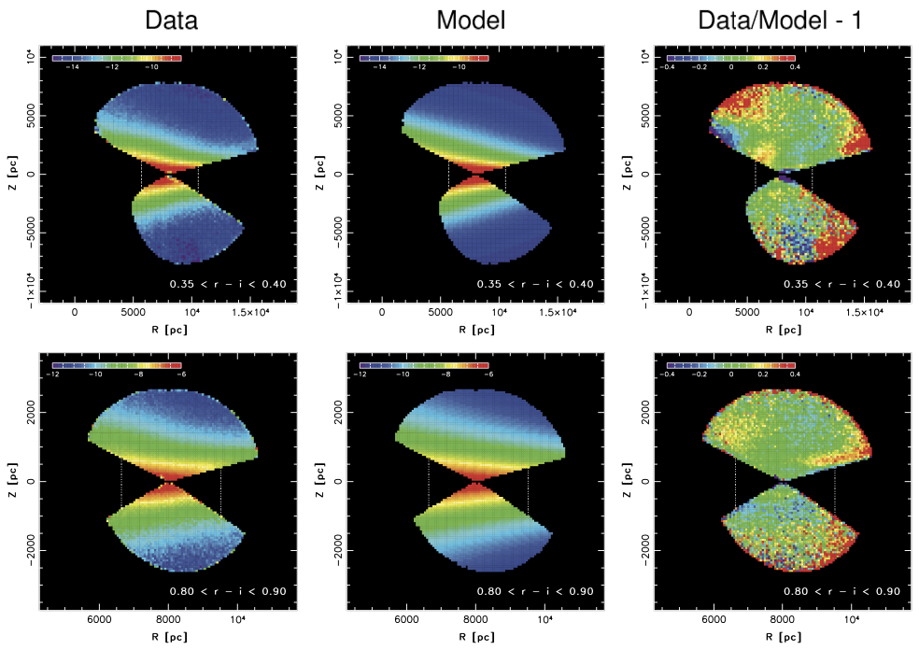
Analysis example: mapping Galaxy with SDSS data
if we know stellar distances, we can study the Milky Way structure
Ivezic+ (2008, ApJ, 684, 287)
Juric+ (2008, ApJ, 673, 864)

Slide 11
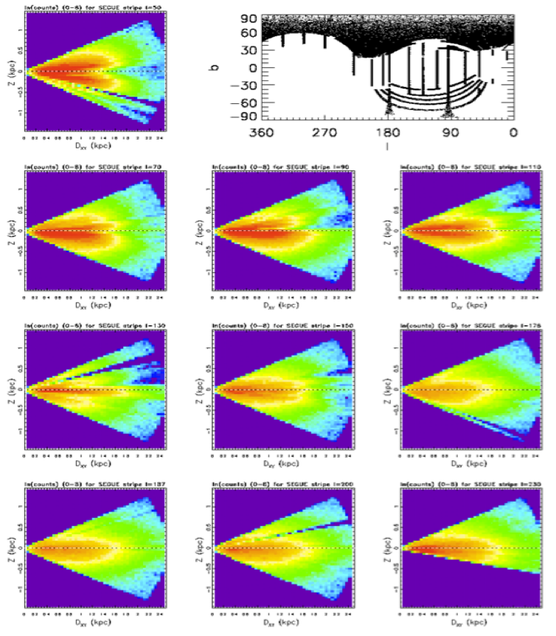
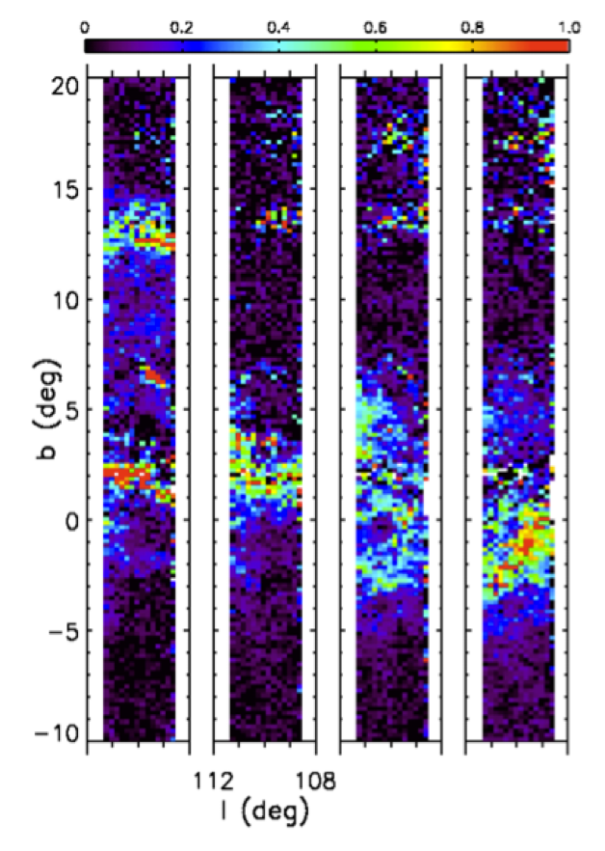
We can map interstellar dust, too...
if we know stellar distances, we can study the Milky Way structure
furthermore, at low galactic latitudes, we can map dust (and its properties), too
left: differences in median A_{r} for D~ 1, 1.5, 2, 2.5 kpc
dust at b ~ 2º and b~13º is confined to D~1-1.5 kpc
dust at -3º < b < 0º is at D~2 kpc
Stellar counts
Dust tomography
Berry+ (2012, ApJ, 757, 166)

Slide 12
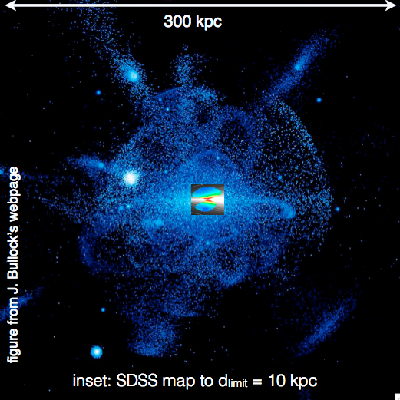
Milky Way science with upcoming coadded LSST data
Distance limits for
(very numerous!)
turn-off stars:
A few hundred million turn-off stars (with [Fe/H]!) out to ~100 kpc.
We will go beyond the limit of 100 kpc for main sequence stars with luminous variable stars RR Lyrae!
DES:
40 kpc
12% sky
LSST:
100 kpc
50% sky
SDSS:
10 kpc
25% sky
7

Slide 13
SDSS
gri
3.5’x3.5’
r~22.5
3 arcmin is 1/10 of the full Moon’s diameter
LSST’s field of view is 3000 times larger

Slide 14
HSC
gri
3.5’x3.5’
r~27
3 arcmin is 1/10 of the full Moon’s diameter
like LSST depth (but tiny area)
LSST will deliver 5 million such images

Slide 15
Time Domain: ”objects changing in time”
1) positions:
a) fast: asteroids
b) slow: stellar proper motions
2) brightness: a) cosmic explosions, b) variable stars (periodic, irregular, etc.), and everything else...
Eyer & Mowlavi 2007

Slide 16
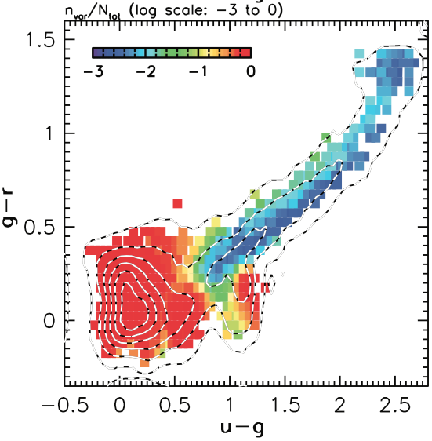
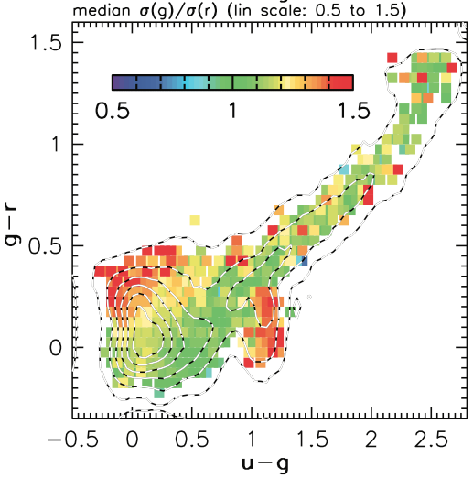
The fraction of variable point sources in SDSS
The sample is dominated by quasars and variable stars called RR Lyrae.
With rms > 0.05 mag and g<20.5
Sesar+2007
21

Slide 17
Single-band light curves for c-type RR Lyrae and eclipsing binaries (top panels) are almost indistinguishable (especially when the noise is large)... But when the color variation (bottom panels) is available, there is no ambiguity!
An example: light curve analysis for periodic variable stars
light curve
light curve
RR Lyr
eclipsing binary
RR Lyr
color variation
color variation
eclipsing binary

Slide 18
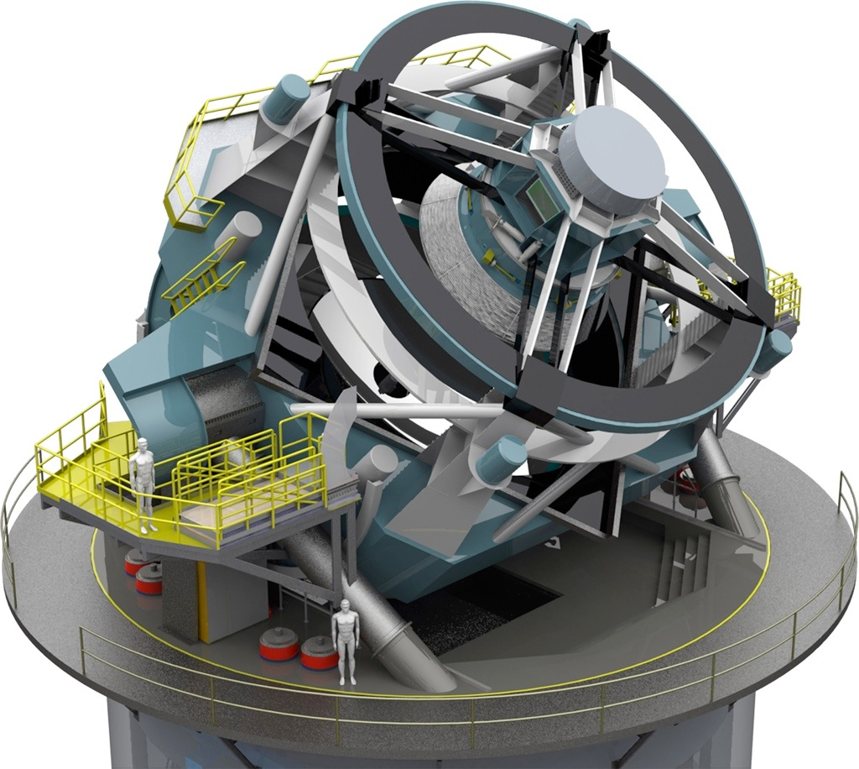
Transients with LSST
Image 1
Image 2
Difference
Additional “follow up” data obtained to:
- confirmation and classification
- provide better temporal resolution
- use different filters/wavelengths
- obtain spectra (distance!)
- other measurements (e.g. polarization) polarimetry)
Alert!
Image 1
Image 2
Difference
~10 billion alerts
Alerts can trigger “Follow up” observations:

Slide 19
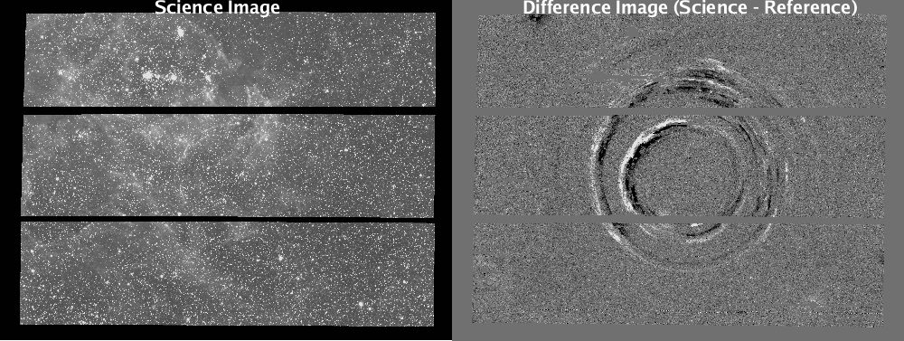
Not only point sources - echo of a supernova explosion:
Becker et al.

Slide 20
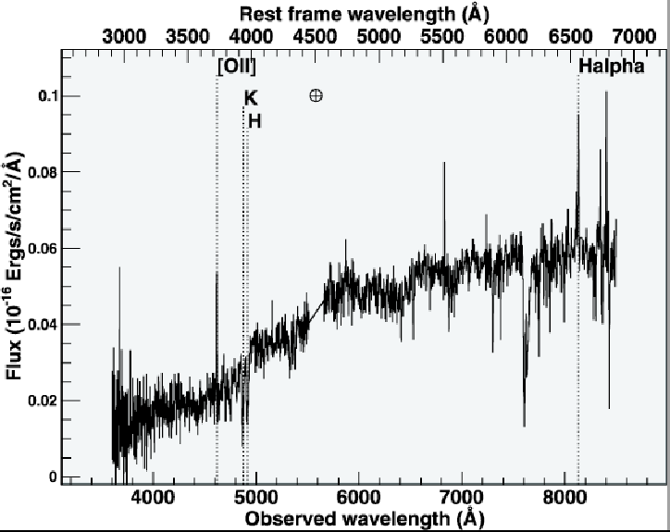
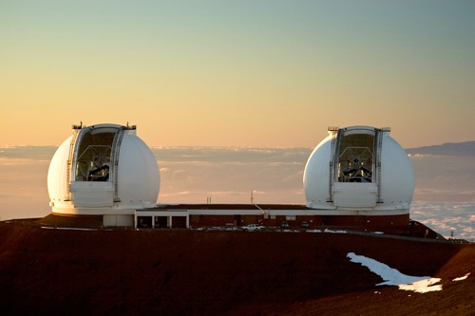
Modern observational methods in astronomy
Large telescopes (~10m, soon 30-40m): faint objects, especially spectroscopy
The Keck telescopes on Mauna Kea (Hawaii)

Slide 21
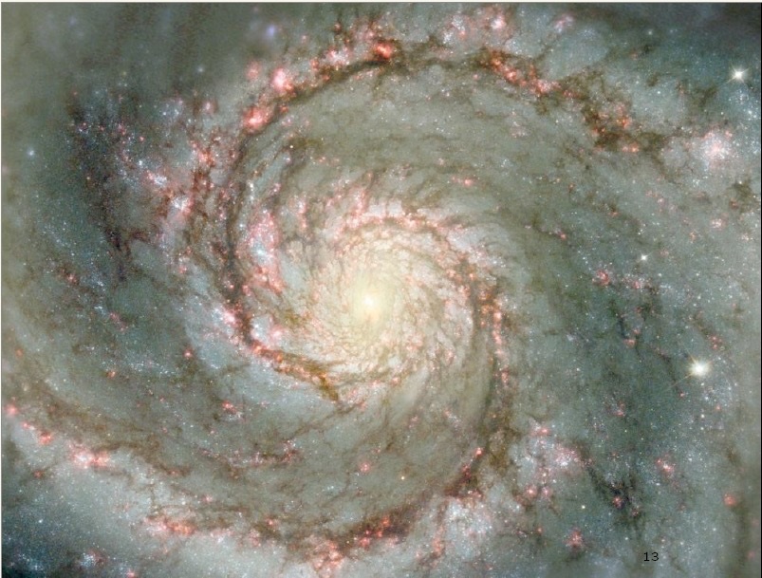
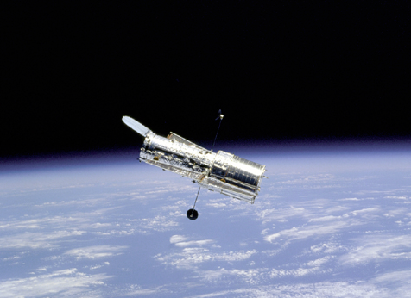
Modern observational methods in astronomy
Telescopes above the atmosphere: high angular resolution (e.g., the Hubble Space Telescope, JWST) and probe other wavelength regions (X-ray, radio, infrared, submm)
The HST in orbit and an example of a galaxy image

Slide 22
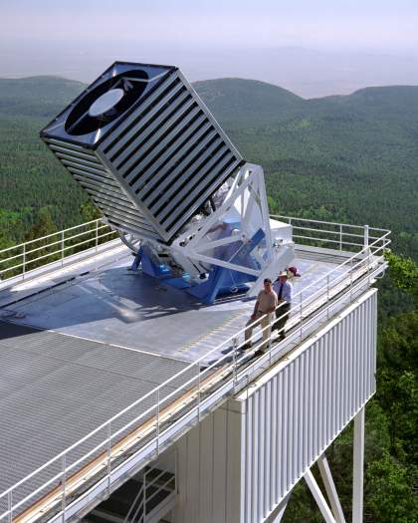
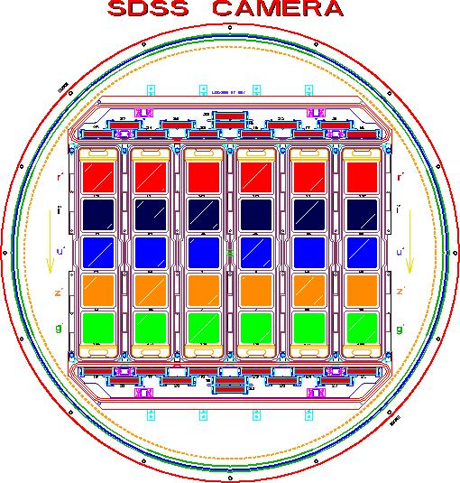
Modern observational methods in astronomy
Large telescopes on the ground
Telescopes above the atmosphere (spacecrafts)
Large sky surveys: digital sensor technology (CCD), information technology (data processing and data distribution), many objects observed at the same time
SDSS
Modern astronomical surveys detect billions of objects: huge statistical power for studying the history and structure of the Universe

Slide 23
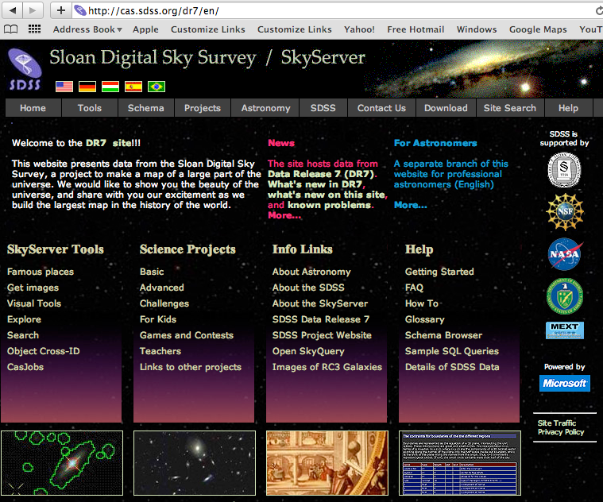
Astronomy “from your armchair”
Data products
available to everyone
around the world at
any time they want it!

Slide 24
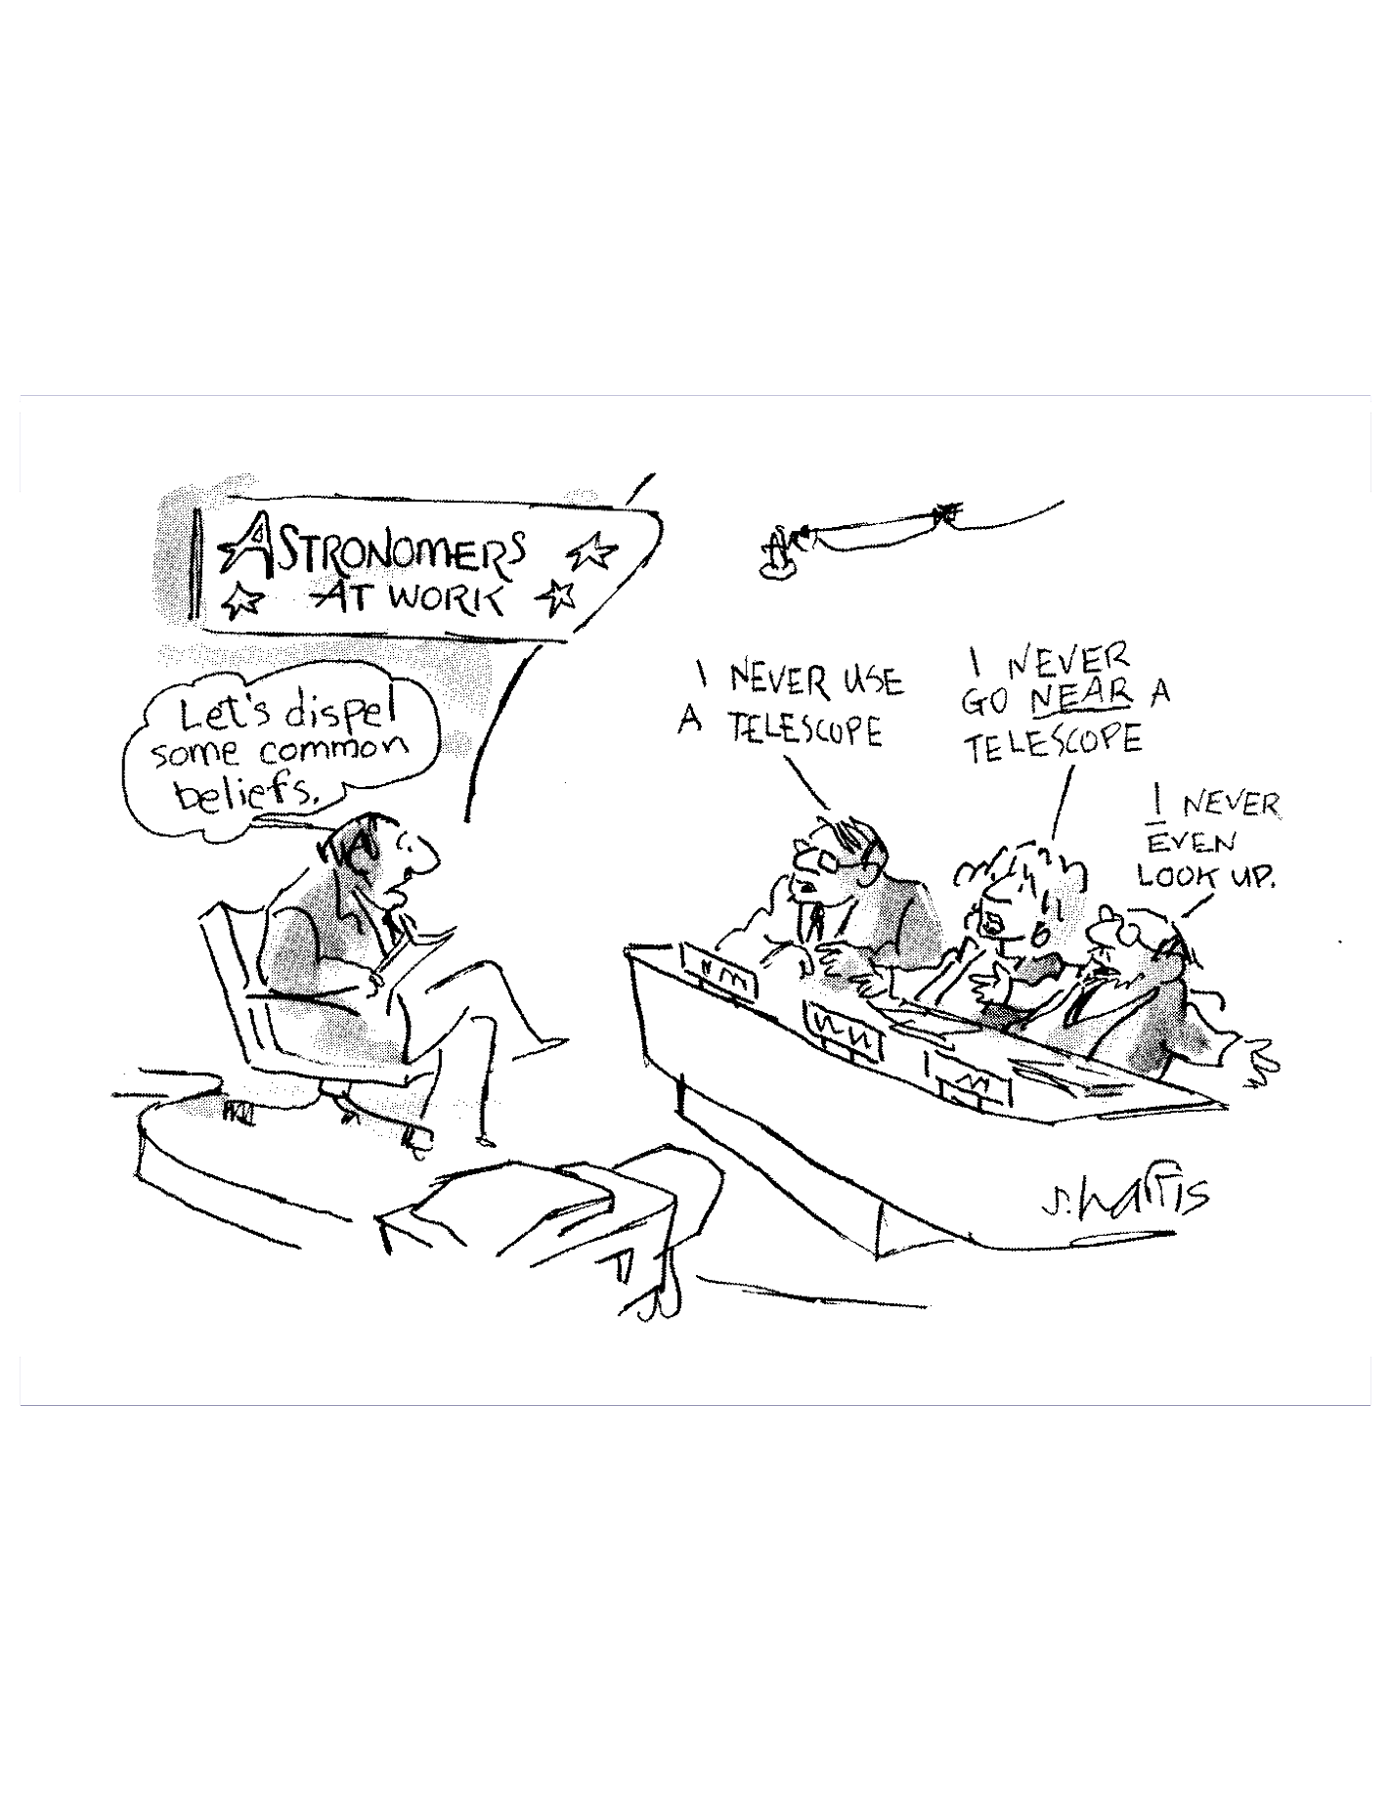
“Ask Not What Data You Need To Do Your Science,
Ask What Science You Can Do With Your Data.”
A change of
paradigm
for how we
do astronomy!
The era of surveys...
Standard: “What data do I have to collect to (dis)prove a hypothesis”?
Data-driven: “What theories can I test given the data I already have?”

Slide 25
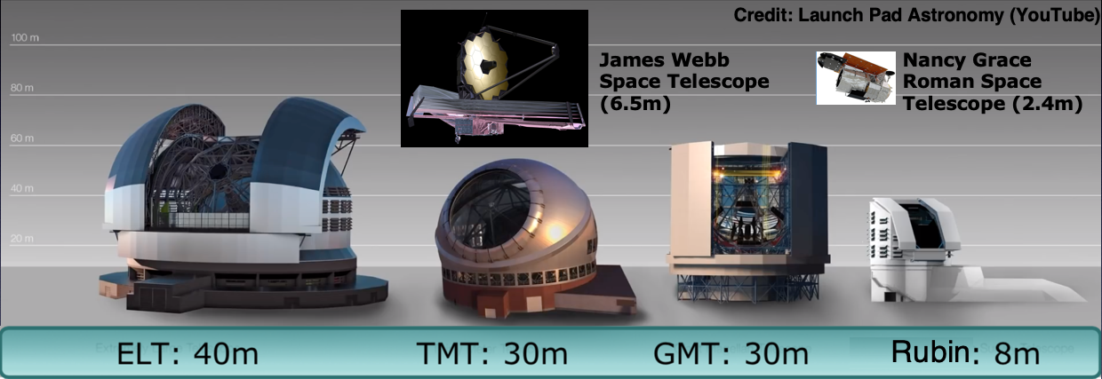
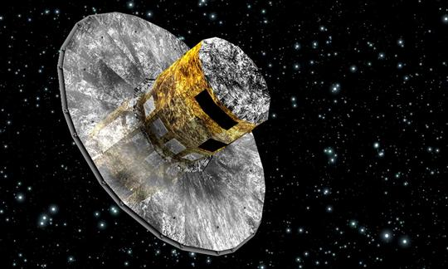
Modern observational facilities
Gaia
ELT: ~40m TMT: ~30m GMT: ~25m Rubin: 8.4m

Slide 26
Modern observational facilities
Gaia
ELT: ~40m TMT: ~30m GMT: ~25m Rubin: 8.4m
Rubin Obs. will not have the largest mirror but will have by far the largest product of the mirror area and the field-of-view size (etendue or throughput): a survey machine!

Slide 27
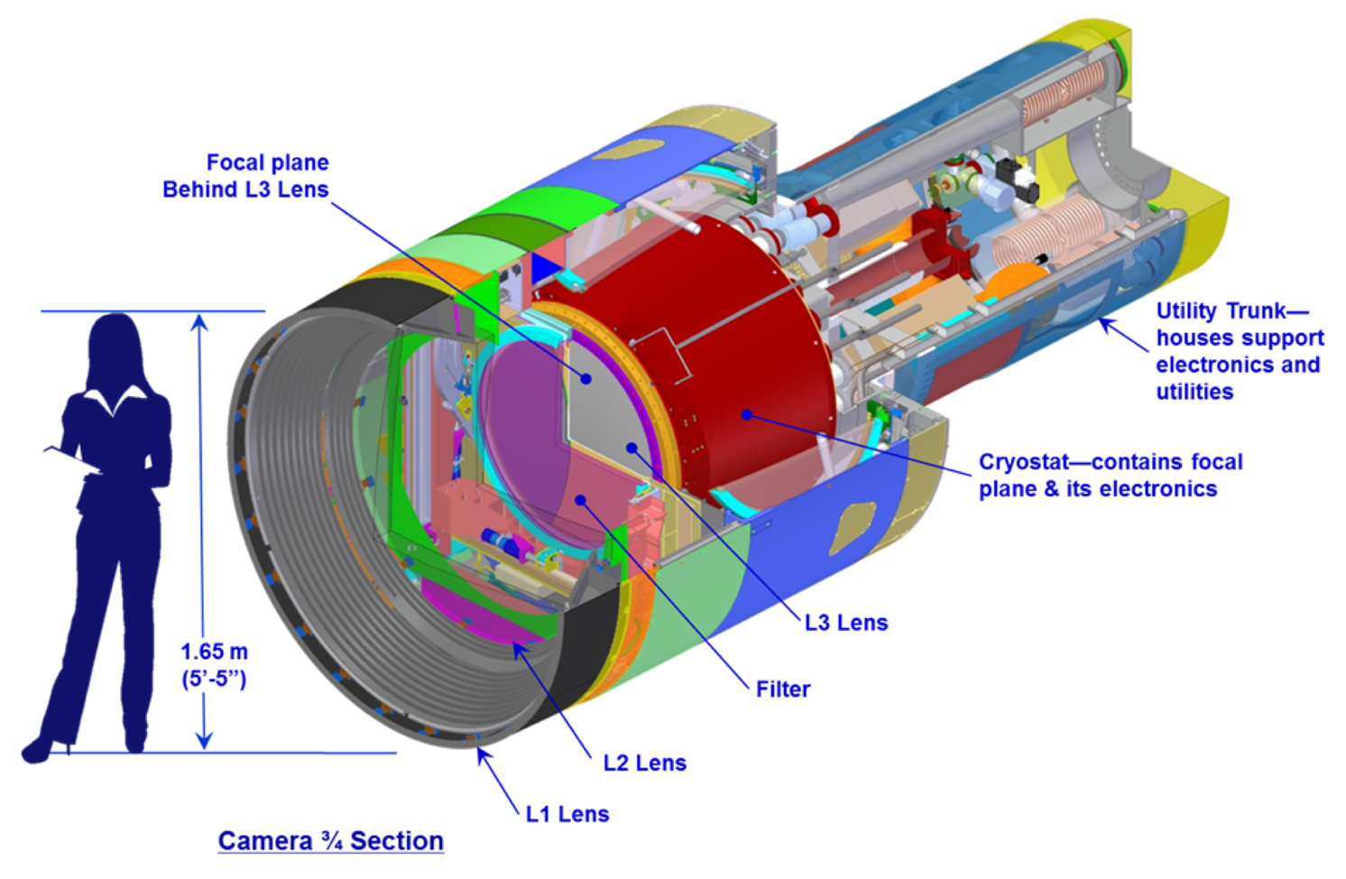
LSST camera
The largest astronomical camera: 2800 kg, 3200 Megapix

Slide 28
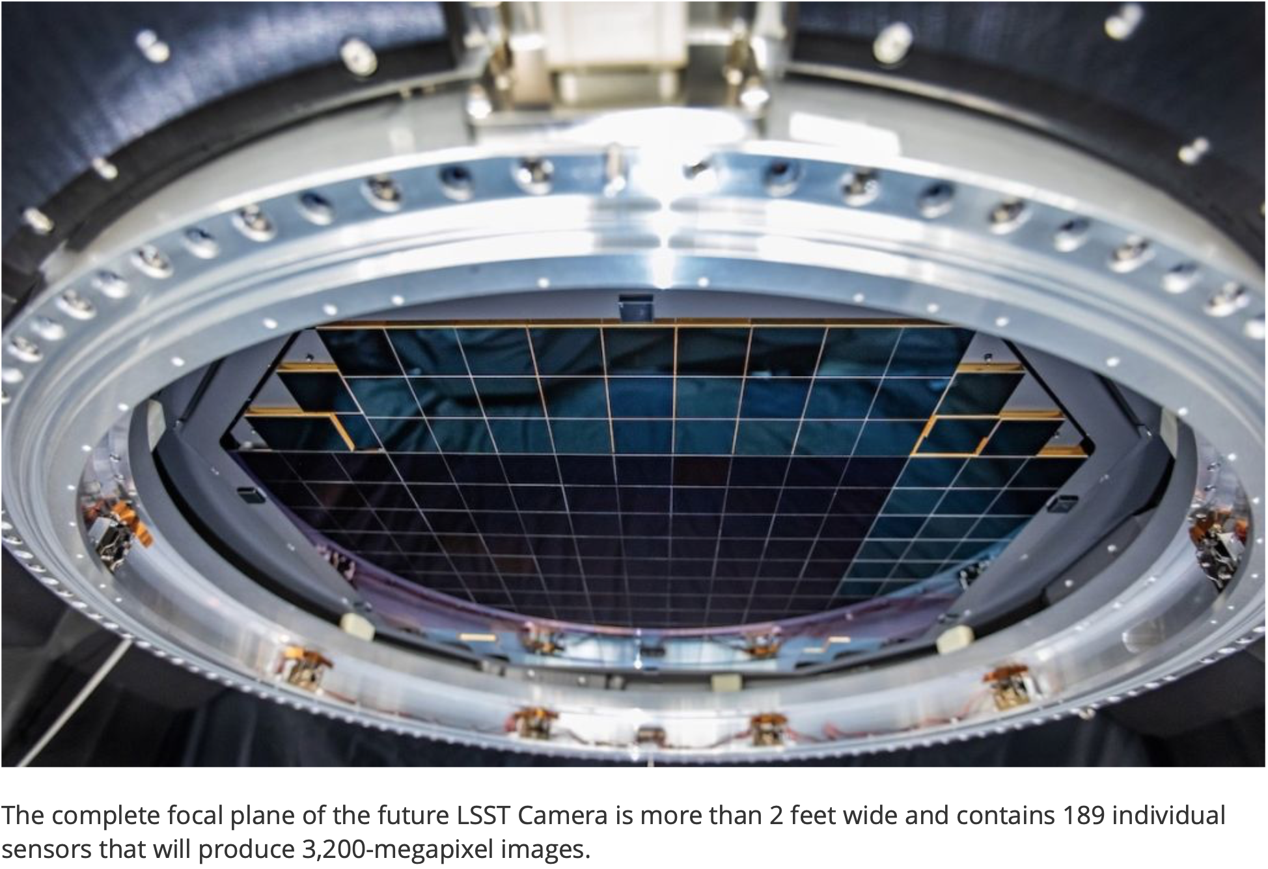

Slide 29

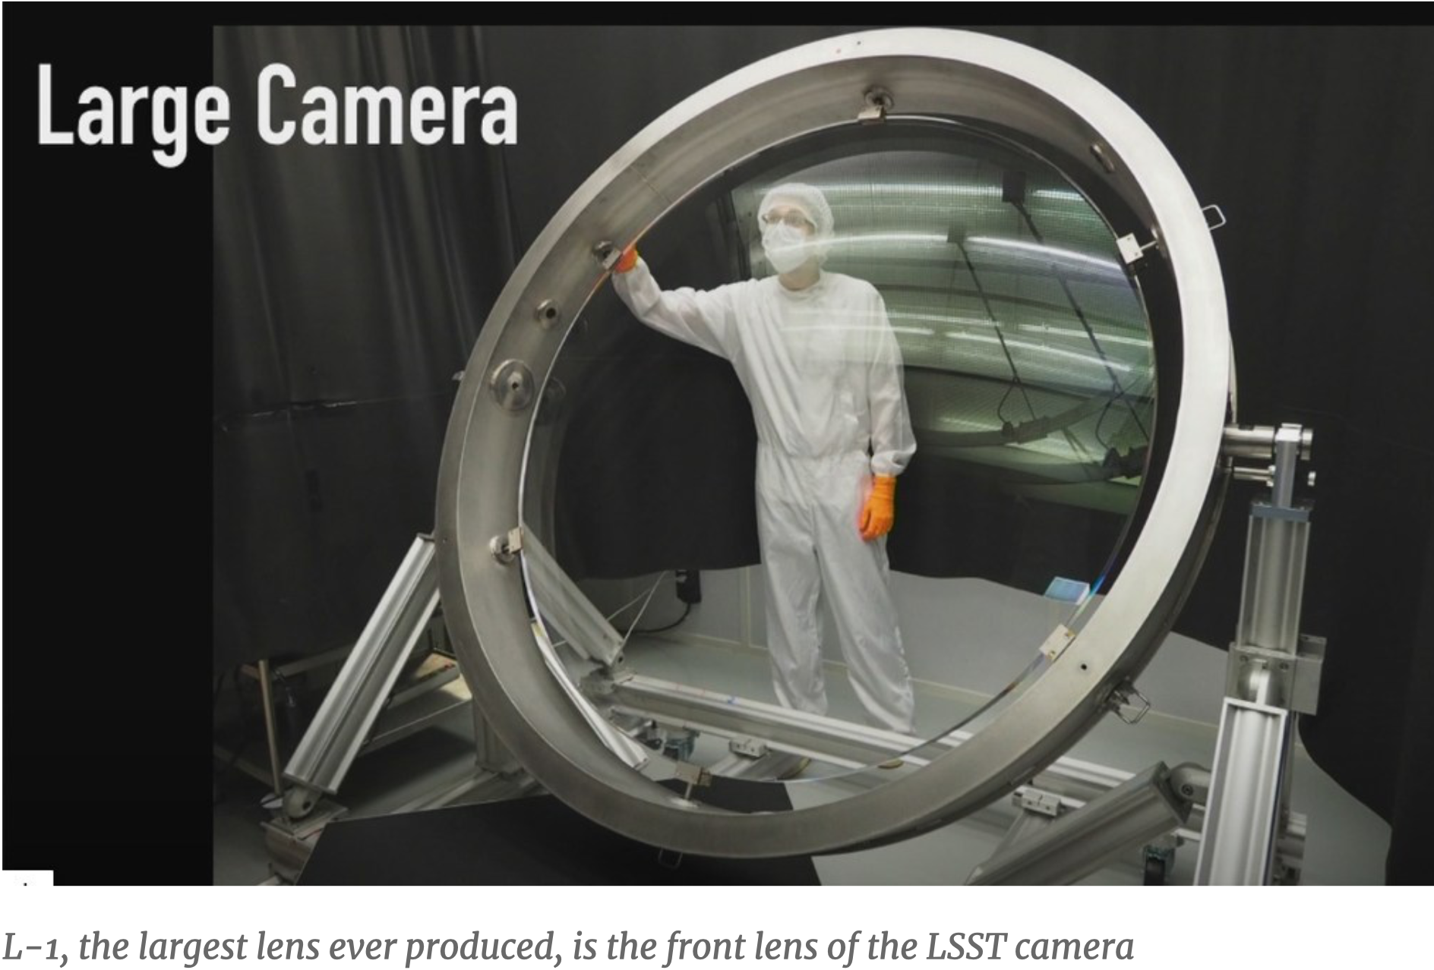

Slide 30
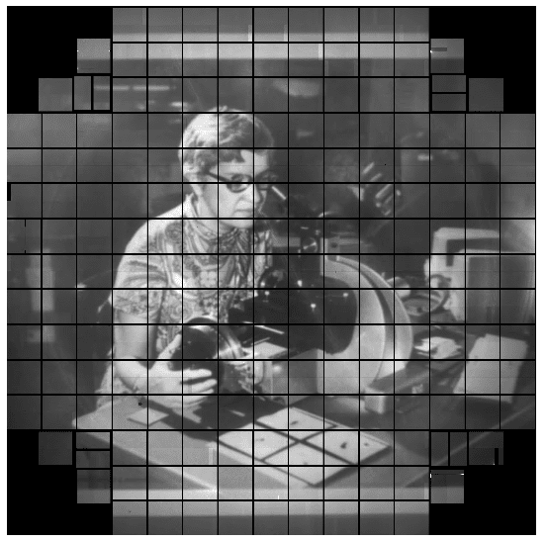

It works!
Vera C. Rubin
(1928-2016)
14

Slide 31
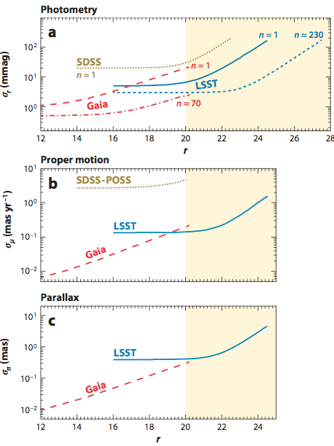
Stellar astrometry & photometry from Gaia and LSST
Photometric accuracy: random errors 0.005 mag, calibration to 0.01 mag; for light curves, LSST “takes over from Gaia” around r ~ 17
Time-resolved measurements: photometric variability, and parallax and proper motions from astrometric measurements
Gaia vs. LSST: complementarity of the two surveys: photometric, proper motion and trigonometric parallax errors are similar around r=20
Ivezić, Beers, Jurić 2012, ARA&A, 50, 251
22

Slide 32
Data analysis challenges in the era of Big Data
1) Large data volume (petabytes)
2) Large numbers of objects (billions)
3) Highly multi-dimensional spaces (thousands)
4) Unknown statistical distributions
5) Time-series data (irregular sampling)
6) Heteroscedastic errors, truncated, censored and missing data
7) Unreliable quantities (e.g. unknown systematics and random errors)
The bottleneck is not any more data availability but instead our ability to extract useful and reliable information from data.

Slide 33
Some tools and methods you will learn at the VOSS23…
o Correlation coefficients (many dimensions, missing data)
o The bootstrap and the jackknife methods
o Maximum Likelihood Method
o The goodness of fit and model selection
o Bayesian statistics
o Markov Chain Monte Carlo methods
o Regression (“fitting”, LSQ, outliers, regularization)
o Density estimation (“multi-dimensional histograms”)
o Clustering (kernel, parametric)
o Classification (supervised and unsupervised, active learning)
o Dimensionality Reduction (PCA, ICA, LLE and friends)
o Time-series analysis (periodogram, stochastic processes)
These topics are not typically taught to astronomers in graduate school. Mario Jurić: “Astrostatistics and astroinformatics are the new calculus!”

Slide 34
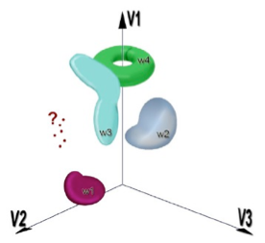
Statistical analysis of a massive dataset: LSST example
A large (100 PB) database and sophisticated analysis tools: for each of 40 billion objects there will be about 1000 measurements (each with a few dozen measured parameters)
10,000-D space with 40 billion points
Characterization of known objects
Classification of new populations
Discoveries of unusual objects
Data mining and knowledge discovery
Clustering, classification, outliers

Slide 35
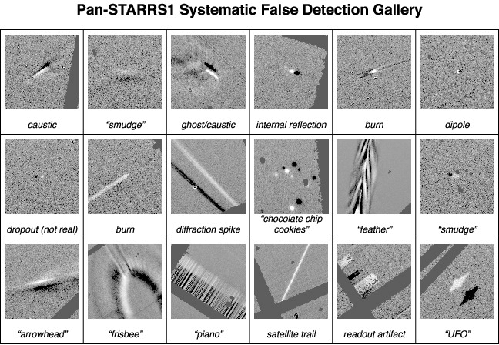
It is often not straightforward
to identify alerts worth
following: need to first reject instrumental artefacts, and then classify astrophysical sources to select those that are “most interesting”
Clustering, classification, outliers…

Slide 36
Outline
1) The Milky Way – our own galaxy
2) Time domain astronomy
3) Astronomical Surveys
4) Big Data and Machine Learning challenges
5) Discussion and Questions

